Slide 1
Rare Ovarian Cancers:
Are We Making Progress?
David M. Gershenson, MD
The University of Texas MD Anderson Cancer Center

Slide 2
Disclosure Information
Employment: University of Texas MD Anderson Cancer Center
Grant Support: NCI (NRG Oncology), Novartis
Consulting Agreement: Genentech
Royalties: Elsevier, UpToDate
Equity Interests: Biogen, Celgene, Johnson & Johnson

Slide 3
Ovarian Sex Cord-Stromal Tumors
Sex Cord-Stromal Tumors
Granulosa-Theca Tumors
Sertoli-Leydig Cell Tumors

Slide 4
Basic Features:
Granulosa-Theca Tumors
Represent 2% of all ovarian malignancies
Mean age in 50s but extremely wide age range
Usually stage I and unilateral
Tumor rupture is common
Presentation may be related to estrogen production
Tumor markers: Inhibin, AMH, estradiol
Associated with increased risk of endometrial or breast cancer
Juvenile type may be associated with Ollier’s disease or Maffuci’s syndrome
Almost all have FOXL2 mutation

Slide 5
Basic Features:
Sertoli-Leydig Cell Tumors
Usually stage I and unilateral
Average age = 28 years
May produce testosterone or, less commonly, estrogen
Tumor markers: testosterone, AFP
Biologic behavior depends on:
  Differentiation: Well, Intermediate, Poorly
  Presence of heterologous elements
May be associated with DICER1 mutation

Slide 6
Ovarian Sex Cord-Stromal Tumors
Surgery plays key role in management, including 2ndry CRS
Fertility-sparing surgery possible in most young patients
Rarely involve retroperitoneal lymph nodes
Standard first-line Rx: Platinum-based chemotherapy
Conventional chemotherapy has only moderate activity
Hormonal therapies may be active in granulosa cell tumors
Radiotherapy may have limited role
Discovery of FOXL2 mutations and DICER1 mutations has not yet translated into improved therapy

Slide 7
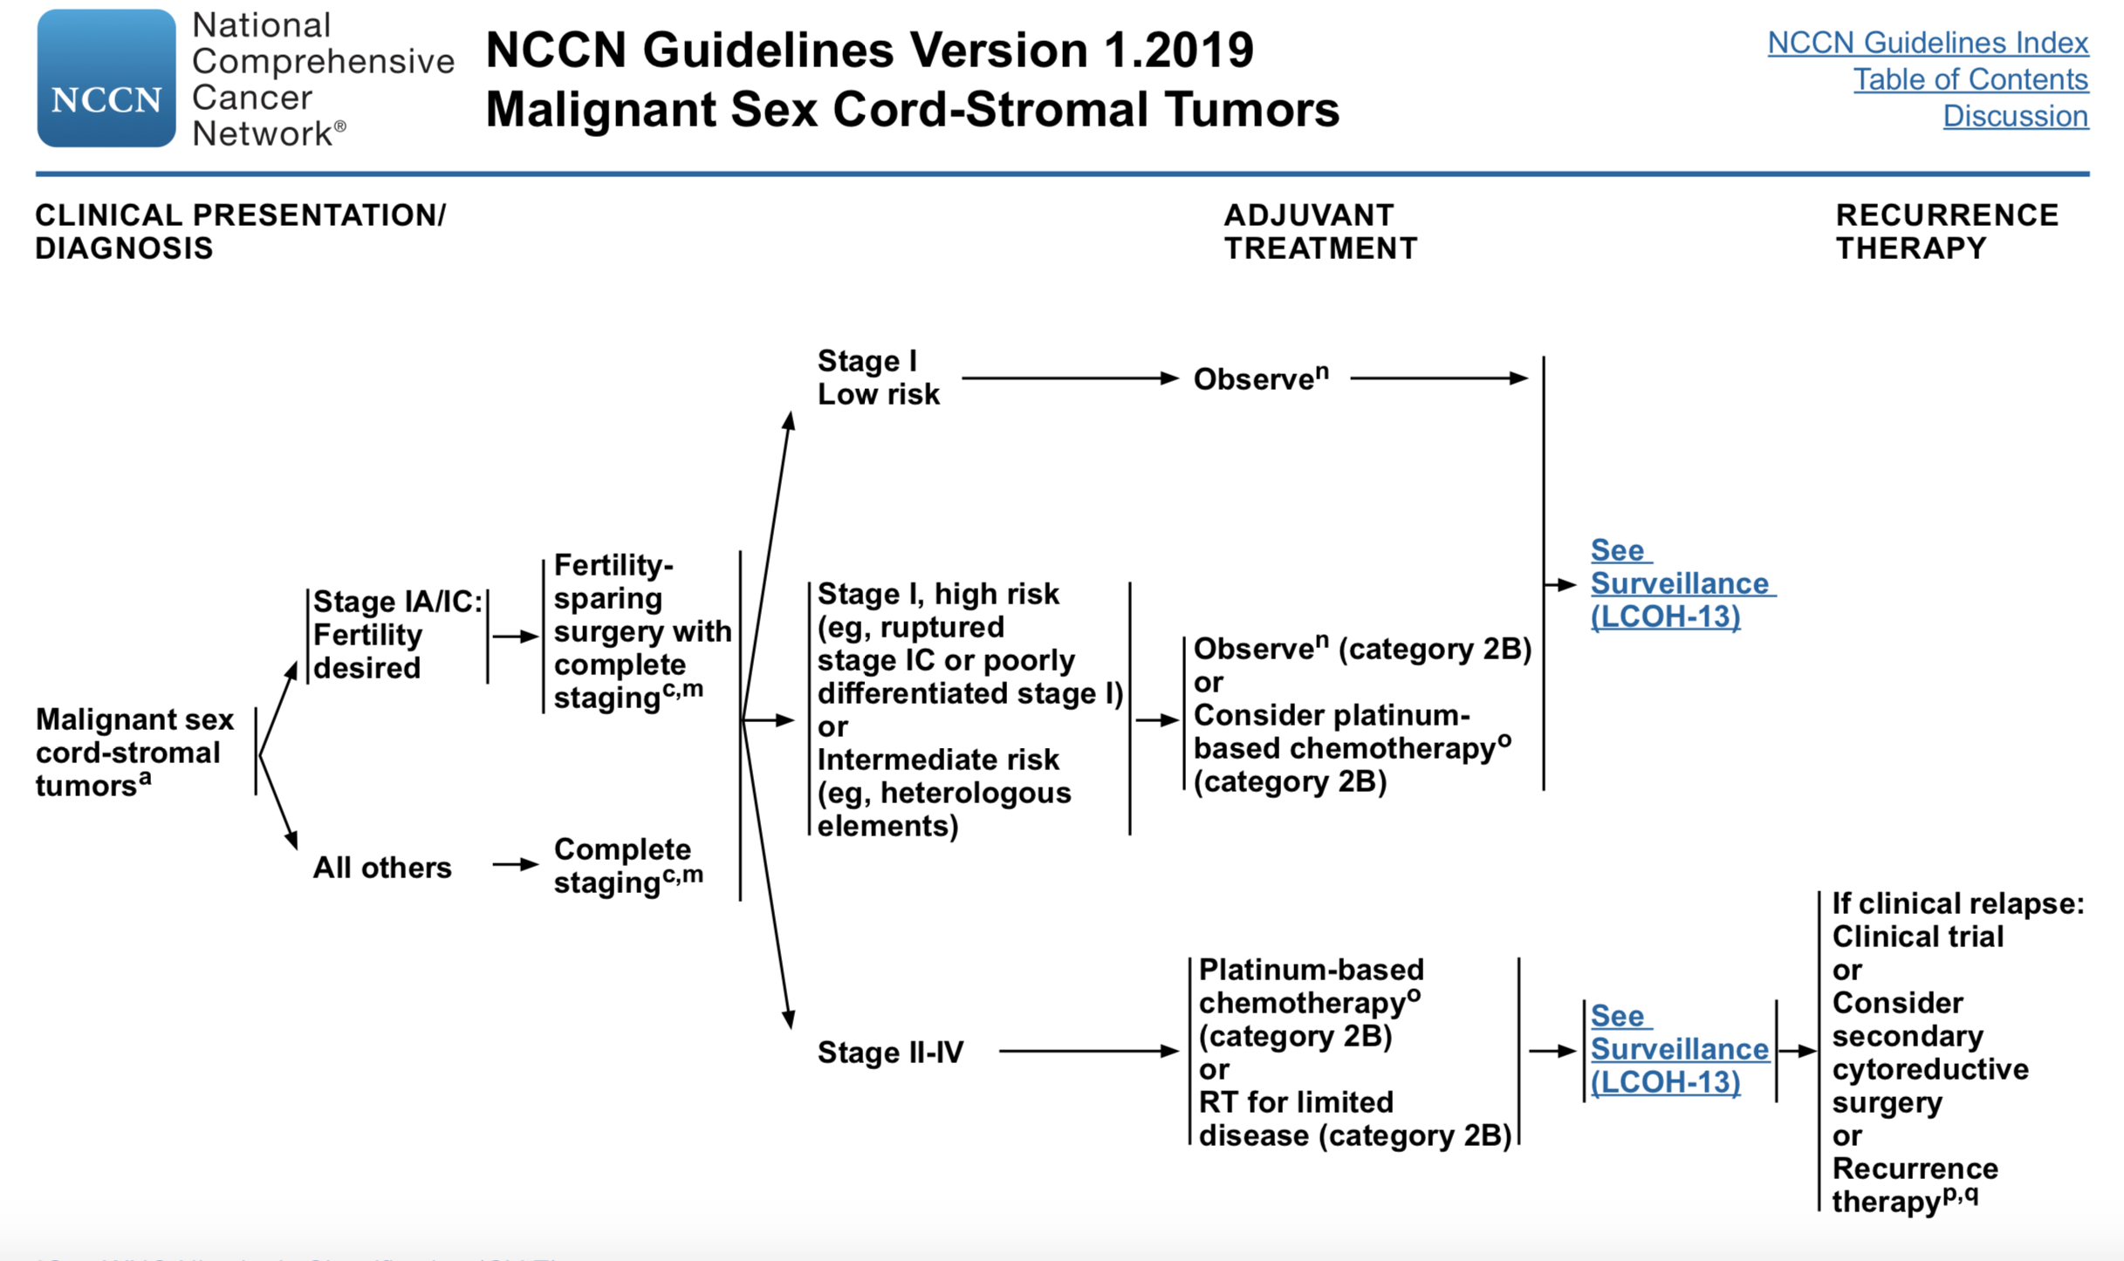

Slide 8

GOG 264
A Randomized Phase II Trial of Paclitaxel and Carboplatin
vs BEP for Newly Diagnosed Advanced Stage and Recurrent
Chemo-Naïve Sex Cord-Stromal Tumors of the Ovary
Stage III-IV or Recurrent Chemo-Naïve SCST of Ovary
Carboplatin AUC 6
Paclitaxel 175 mg/m²
X 6 cycles
Bleomycin 20 U/m²
Etoposide 75 mg/m² d 1-5
Cisplatin 20 mg/m² d 1-5
X 4 cycles
Accrual 52/128

Slide 9
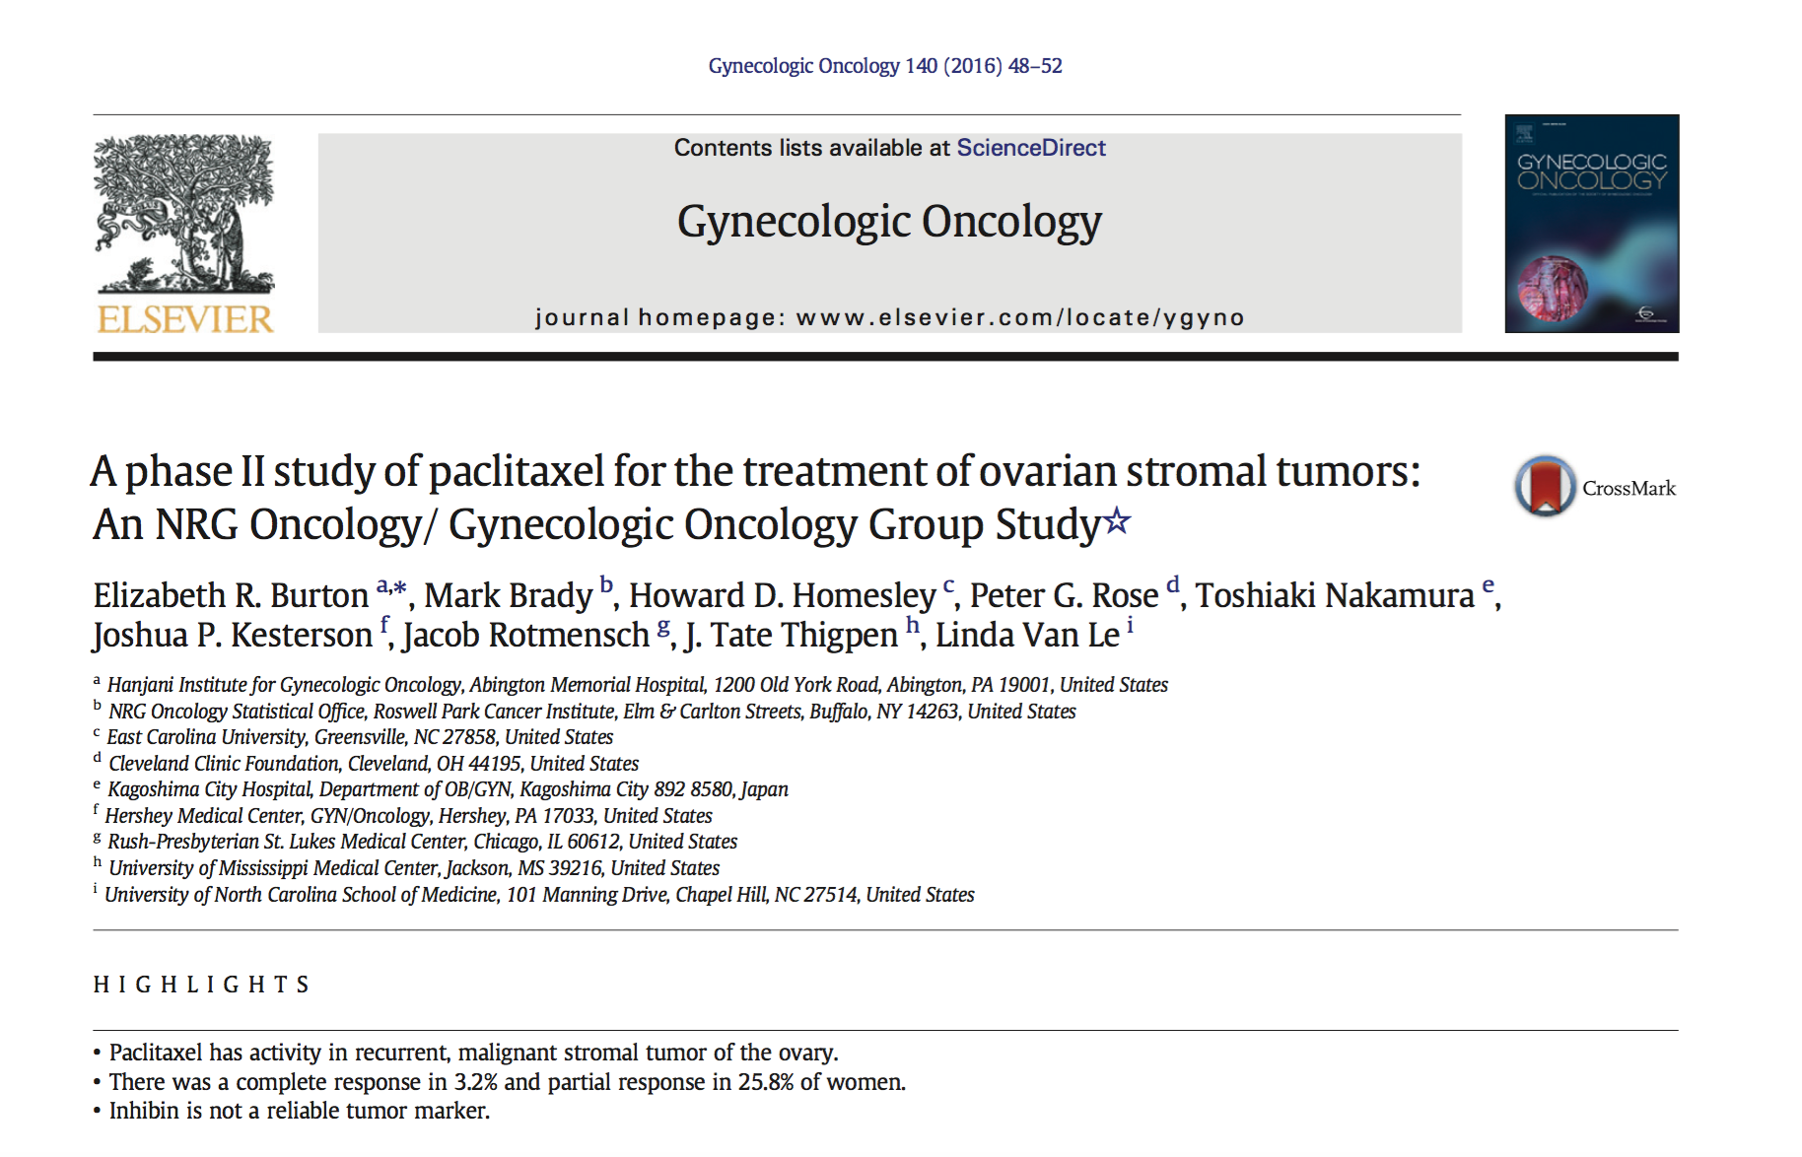

Slide 10
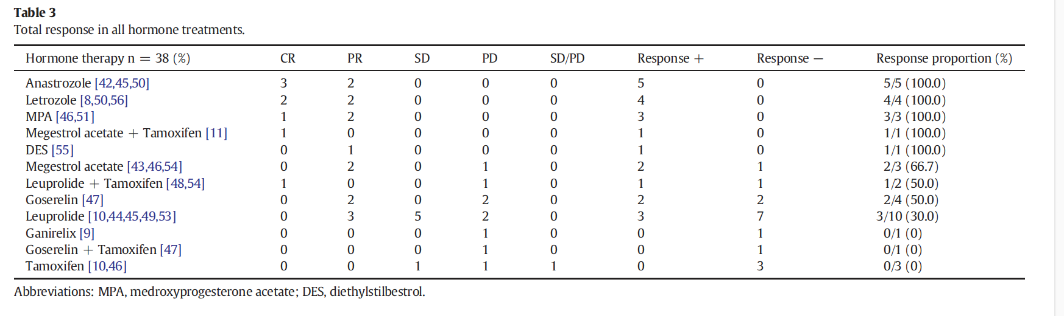
Hormonal Therapy for Recurrent GCT
van Meurs et al.
Gynecol Oncol 2014

Slide 11
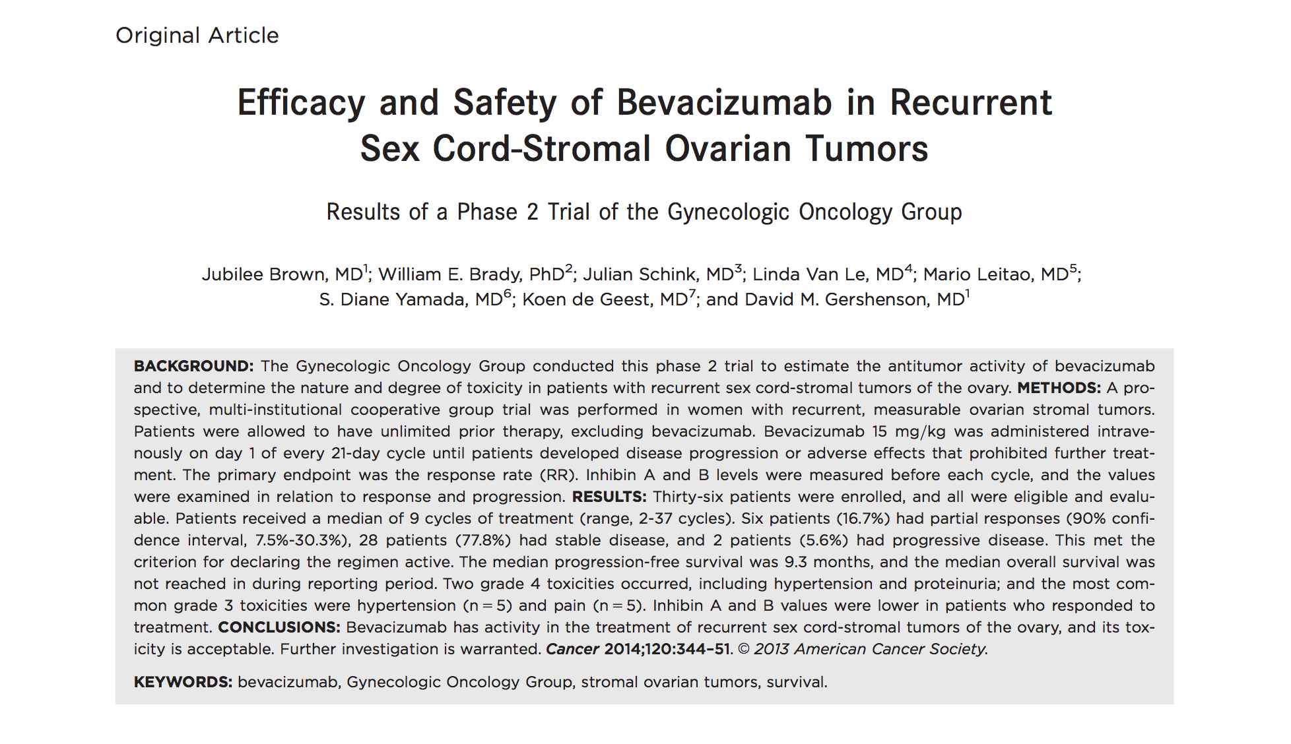
GOG 251

Slide 12
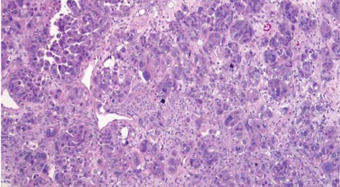
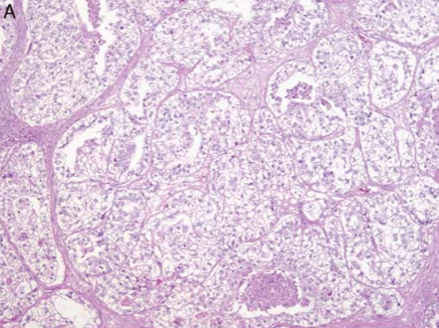
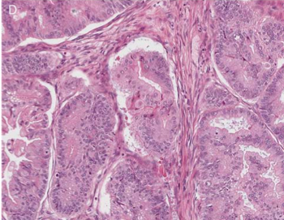
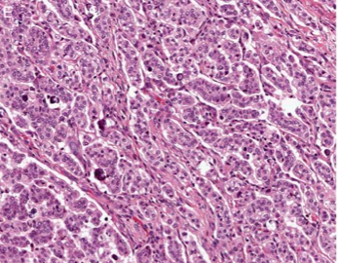
Epithelial Ovarian Cancer
High-Grade Serous
Clear Cell
Mucinous
Low-Grade Serous

Slide 13
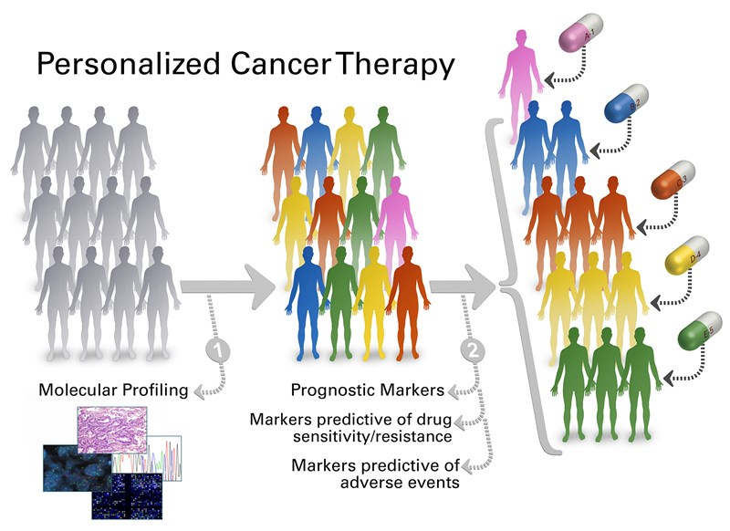
Implementing a Targeted Therapy Strategy
Individualized Cancer Therapy
BIOMARKERS
Notes:
prognostic biomarker provides information about the patients overall cancer outcome, regardless of therapy, whilst a
predictive biomarker gives information about the effect of a therapeutic intervention. Eg Her 2 for breast & c-Kit for GIST

Slide 14
Mucinous carcinoma

Slide 15
Mucinous Ovarian Cancer
Mucinous tumors account for 12-15% of all ovarian neoplasms
Majority of mucinous ovarian tumors are benign (75%), whereas borderline (LMP) and carcinomas account for 10% and 15%, respectively
Mucinous carcinomas account for 5% of advanced stage EOC but 25% of stage I EOC (90% 5-yr. survival)
There is both pathologic and molecular evidence suggesting that mucinous ovarian cancer progresses from a benign tumor to an LMP tumor before developing into a carcinoma
Notes:
Mucinous tumors accounts for…
There are pathological and molecular evidence ……

Slide 16
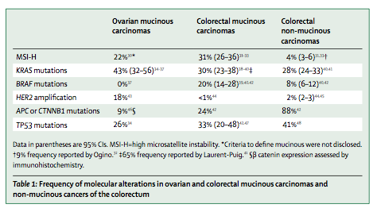
Mucinous Carcinoma:
Molecular Biomarkers
Kelemen & Köbel
Lancet Oncol 2011

Slide 17
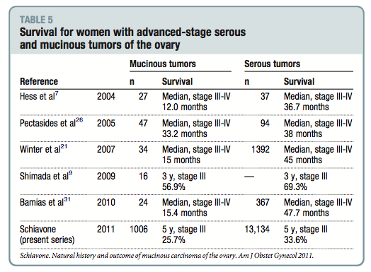
Survival:
Mucinous Carcinoma vs HGSC

Slide 18
mEOC/GOG 241: A Randomized Phase III Trial of Capecitabine/Oxaliplatin
vs. Paclitaxel/Carboplatin +/- Bevacizumab in Patients with
Previously Untreated Mucinous Ovarian Cancer
Stage II-IV or Recurrent Stage I Mucinous Carcinoma of Ovary
(N = 332)
Carboplatin AUC 5/6
Paclitaxel 175 mg/m²
X 6 cycles
Oxaliplatin 130 mg/m²
Capecitabine 850 mg/m² bd
X 6 cycles
Bevacizumab
15 mg/kg
Q. 3 wk. X 6
No
Bevacizumab
Bevacizumab
15 mg/kg
Q. 3 wk. X 6
No
Bevacizumab

Slide 19
mEOC/GOG 0241
Target accrual = 332
Closed early for slow accrual: Only 50 pts accrued (34 UK, 16 US)
40/50 cases available for central pathology review: Only 18 (45%) were diagnosed as primary mucinous ovarian cancer
Neither of experimental regimens (Oxal/Cape vs. Pac/Carbo or Bev versus no Bev) clearly improved OS or PFS

Slide 20
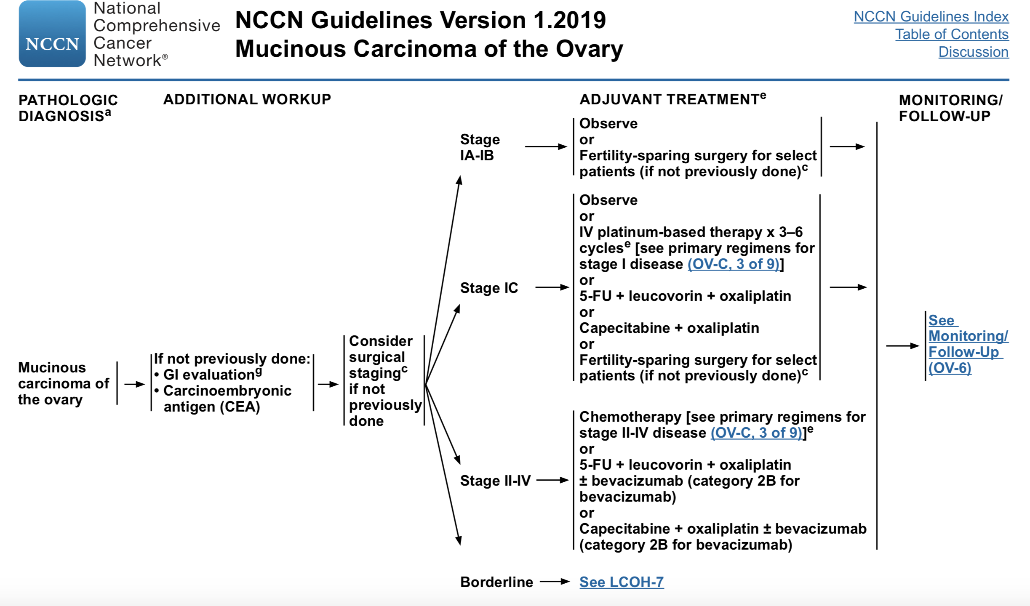

Slide 21
Mucinous Carcinoma:
Future Directions
Advanced stage mucinous carcinoma is rarer than originally thought
Path for progress: Smaller phase II trials or basket trials
Prospective central pathology review is essential
Potential trials:
  Targeting KRAS mutations
  Targeting HER-2/neu amplification
  Immunotherapy: Pts whose tumors have high CD8+ tumor-infiltrating lymphocytes have improved survival
  PI3K/mTOR + MEK inhibitors show synergistic anti-tumor effects preclinically
  Oxaliplatin + dasatinib reduces cancer cell viability and promotes apoptosis in human mEOC cell lines

Slide 22
Clear cell carcinoma

Slide 23
Clear Cell Ovarian Carcinoma (CCC)
Clear cell cancer accounts for 5-10% of all ovarian neoplasms
Thought to arise from endometriosis
Most patients present with disease at early stage
Associated with higher incidence of:
  Thromboembolic phenomena
  Hypercalcemia
Notes:
Mucinous tumors accounts for…
There are pathological and molecular evidence ……

Slide 24
Clear Cell Carcinoma:
Key Pathways & Potential Targets
ARID1A mutation 50%
PI3K/AKT/mTOR pathway 30-40%
Angiogenesis pathway
PD-1 and PD-L1
HNF-1β upregulation 100%
IL6-HIF-1α pathway upregulation 50%
MET amplification 20-30%
HER-2 amplification 14%
PPM1D amplification 10%
Microsatellite instability (MSI) 7-18%

Slide 25
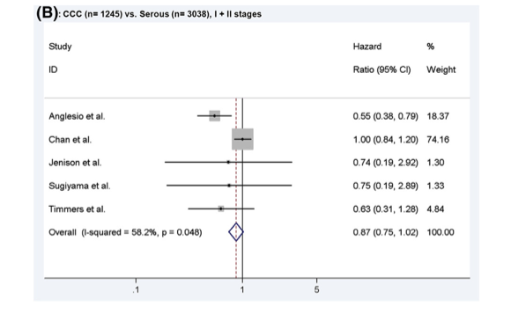
OS in Early Stage EOC:
CCC vs HGSC
Lee et al.
Gynecol Oncol 2011

Slide 26
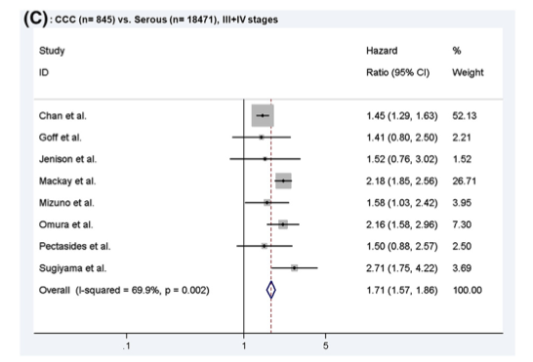
OS in Advanced Stage EOC:
CCC vs HGSC
Lee et al.
Gynecol Oncol 2011

Slide 27
Clear Cell Carcinoma
Trial | Phase | Setting | No. Pts | Agent(s) | Results
JGOG3017 | III | First-line | 667 | Irinotecan/Cisplatin vs Paclitaxel/Carboplatin | 2-yr OS = 85.5% vs 87.4% (NS)
GOG 268 | II | First-line | 90 | Paclitaxel/Carboplatin + Temsirolimus → Temsirolimus maintenance | 54% with PFS > 12 mo No better than historical controls
GOG 254 | II | Recurrent | 35 | Sunitinib | ORR = 6.7% Median PFS = 2.7 mo
NRG-GY-001 | II | Recurrent | 13 | Cabozantinib | ORR = 0% Median PFS = 3.6 mo
Princess Margaret Cancer Centre Trial | II | Recurrent | 40 | ENMD-2076 | ORR = 5% Median PFS = 3.7 mo

Slide 28
Clear Cell Carcinoma
Trial | Phase | Setting | No. Pts | Agent(s) | Results
GOG 283 | II | Recurrent | 35 | Dasatinib | Pending analysis
NiCCC | Randomized II | Recurrent | -- | Nintedanib vs SOC | Recruiting
NRG-GY-014 | II (basket) | Recurrent | -- | Tazemetostat | Recruiting
NRG-GY-016 | II | Recurrent | -- | Pembrolizumab + Epacadostat | Recruiting
ATARI/NCRI | II | Recurrent | -- | AZD6738 +/- Olaparib | Not yet recruiting

Slide 29
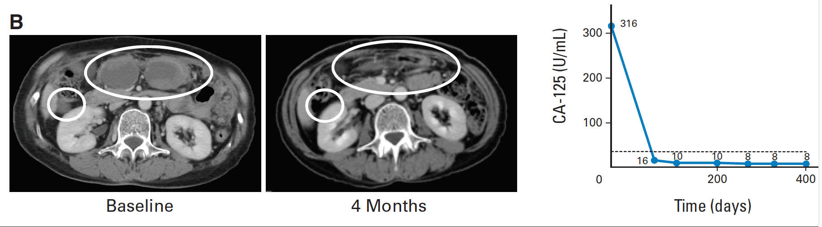
Nivolumab in Platinum-Resistant EOC
60 y/o woman with recurrent, platinum-resistant clear cell carcinoma of ovary
Treated with Nivolumab after 3 lines of conventional chemotherapy
Patient continues to be in CR after 1-year course
Hamanishi et al.
J Clin Oncol 2015

Slide 30
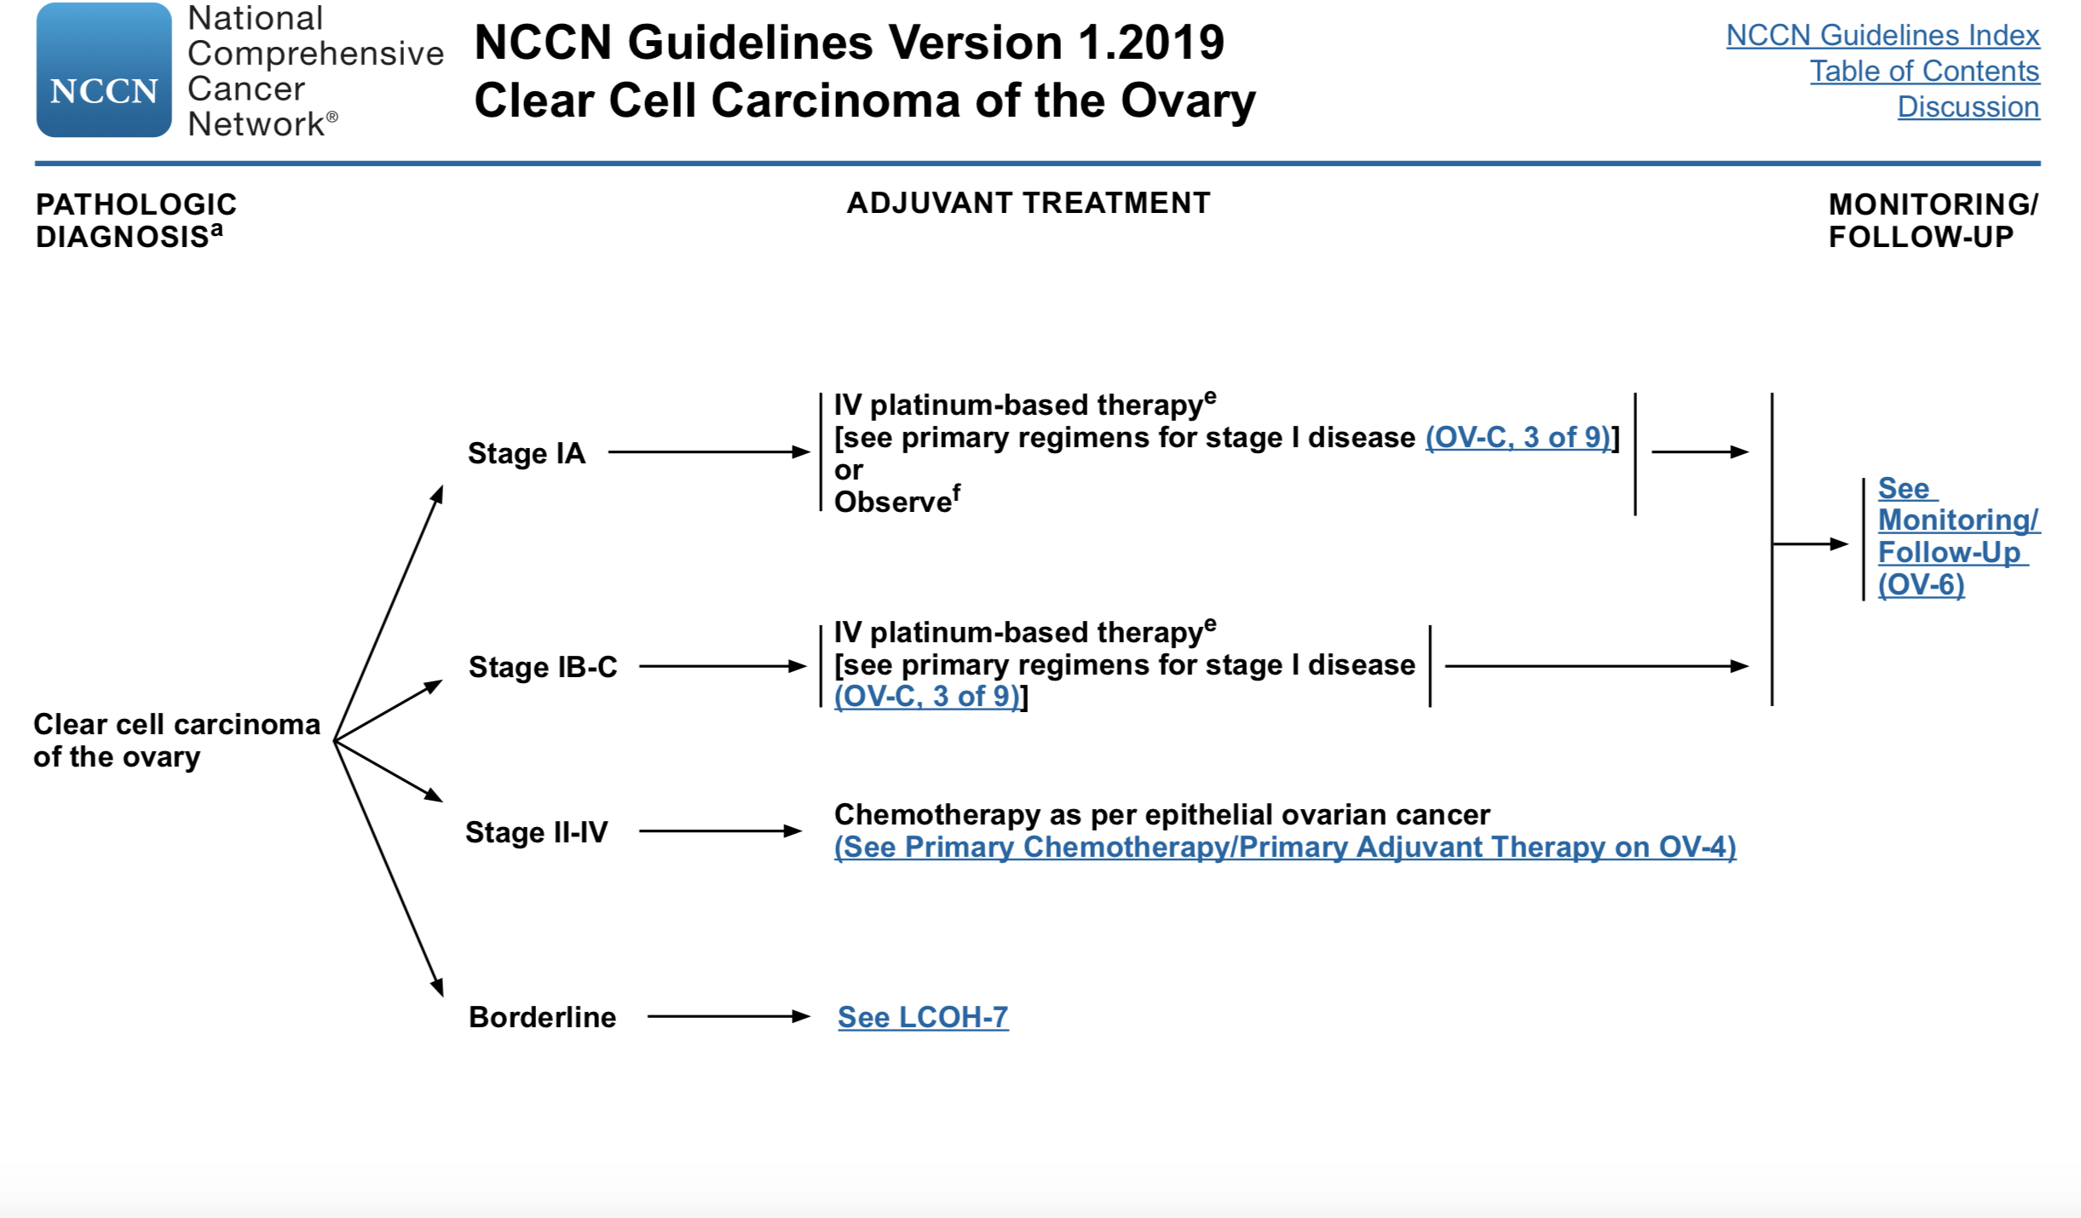

Slide 31
Clear Cell Carcinoma:
Future Directions
Continue to conduct phase II or basket trials
Targets of most interest:
  PD-1 or PD-L1
  ARID1A mutation
  PI3K/AKT/mTOR pathway
  Angiogenesis pathway

Slide 32
Low-grade serous carcinoma

Slide 33
Low-Grade Serous Carcinoma (LGSC)
Comprises 10% of serous carcinomas
May arise de novo or as recurrence after serous LMP tumor
Characterized by younger age on average, relative chemoresistance, and prolonged OS compared to HGSC
Malpica et al.
Am J Surg Pathol 2004
Crispens et al.
Obstet Gynecol 2002
Gershenson et al.
Obstet Gynecol 2006

Slide 34
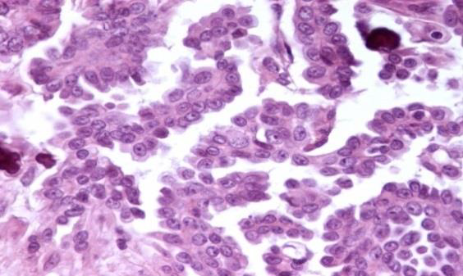
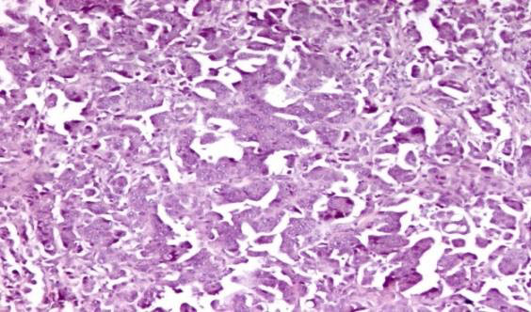
M.D. Anderson Binary Grading System for Serous Carcinomas
Low Grade:
  Mild to moderate nuclear atypia
  Mitotic index of up to 12 mitoses/10 HPF (as secondary feature)
High Grade:
  Marked nuclear atypia
  Mitotic index of > 12 mitoses/10 HPF (as secondary feature)
Malpica et al
Am J Surg Pathol 2004
Bodurka et al.
Cancer 2012
Malpica et al.
Am J Surg Pathol 2007
2014 WHO
Classification
Vang et al.
Am J Surg Pathol 2008

Slide 35
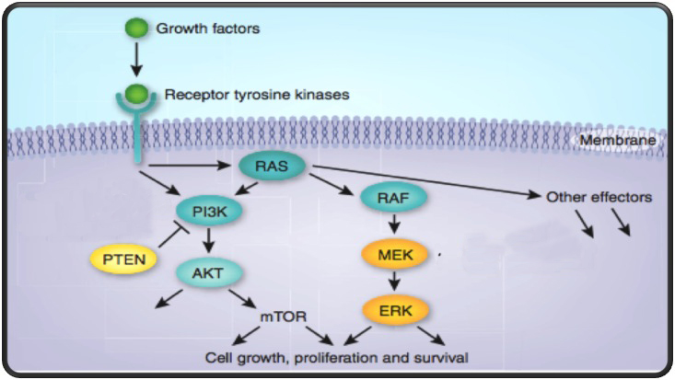
MAP Kinase Pathway
Notes:
MK 2206 is an AKT inhibitor
AZD6244 (ARRY-142886) is a potent, selective, orally-available, small molecule inhibitor of the MAPK, MEK-1/2
68% of low-grade serous tumors have mutations in BRAF or KRAS genes
Mutually exclusive

Slide 36
Molecular Biology of LGSC:
The Emerging Story
Tumor Subtype | BRAF Mutation | KRAS Mutation | NRAS Mutation
Serous BOT | 20-40% | 40% | 0%
LGSC | 5-10% | 20-40% | 9-26%
HGSC | 0% | 0-14% | 0%
Wong et al.
Am J Pathol 2010
Tsang et al.
J Pathol 2013
Grisham et al.
Cancer 2012
Emmanuel et al.
Clin Cancer Res 2014
Jones et al.
J Pathol 2011
Hunter et al.
Oncotarget 2015

Slide 37


Standard Treatment for LGSC
Primary Cytoreductive Surgery
Platinum/Taxane Chemotherapy

Slide 38
Low-Grade Serous Carcinoma is Relatively Chemoresistant
Series of studies demonstrate relative chemoresistance in multiple clinical settings
  First-line Adjuvant: > 40% pts have persistent disease at completion
  Neoadjuvant: Only 4% ORR in first reported study
  Recurrent: Only < 5% ORR in first reported study
Gershenson et al.
Obstet Gynecol 2006
Schmeler et al.
Gynecol Oncol 2011
Schmeler et al.
Gynecol Oncol 2008
Gershenson et al.
J Clin Oncol 2015
Gershenson et al.
Gynecol Oncol 2008
Grabowski et al.
Gynecol Oncol 2016

Slide 39
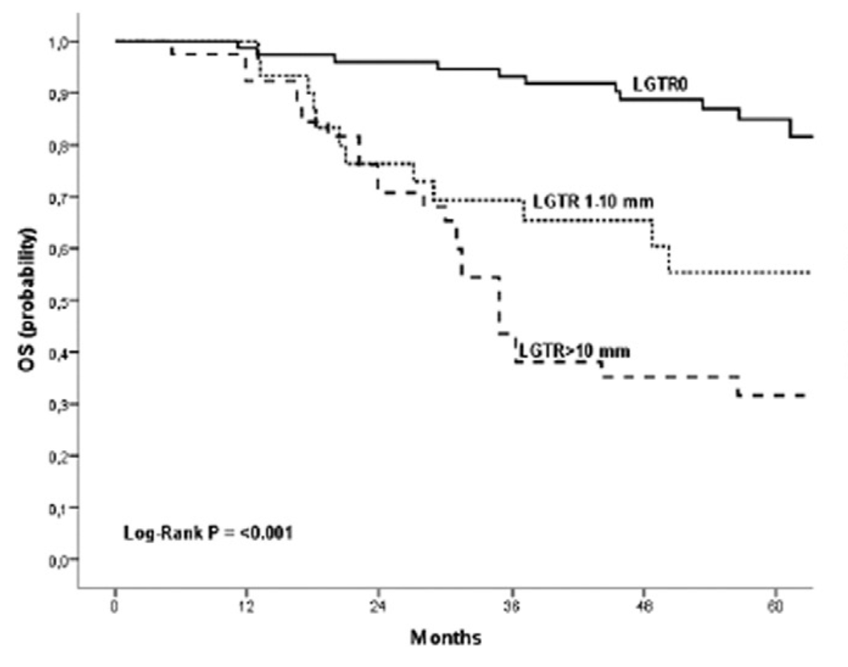
Primary Chemotherapy for LGSC versus HGSC
AGO metadatabase: 5114 pts
Suboptimal debulking:
  39 LGSC pts: RR = 23%
  80 HGSC pts: RR = 90% (p<0.001)
Grabowski et al.
Gynecol Oncol 2016

Slide 40
Key Pathways & Potential Targets:
Low-Grade Serous Carcinoma
MAP Kinase pathway
  KRAS 20-40%
  NRAS 9-26%
  BRAF 5-10%
Endocrine signaling
IGF-1R
Angiogenesis pathway

Slide 41
Individualized Therapeutic Strategies
    Targeted Agents
      Anti-angiogenic therapy
      MEK inhibitors
      BRAF inhibitors
      Combination targeted agents
    Endocrine Signaling
      Aromatase inhibitors
      CDK 4/6 inhibitors

Slide 42
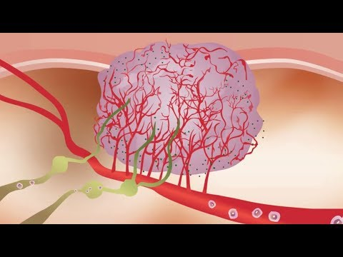
Bevacizumab in Low-Grade Serous Carcinoma
Study | No. Patients | Outcome
Grisham et al. Int J Gynecol Cancer 2014 | 17 | CR = 0 PR = 40% SD = 33%
Dalton et al. Gynecol Oncol 2017 | 40 (45 separate regimens) | CR = 7.5% PR = 40% SD = 30%

Slide 43
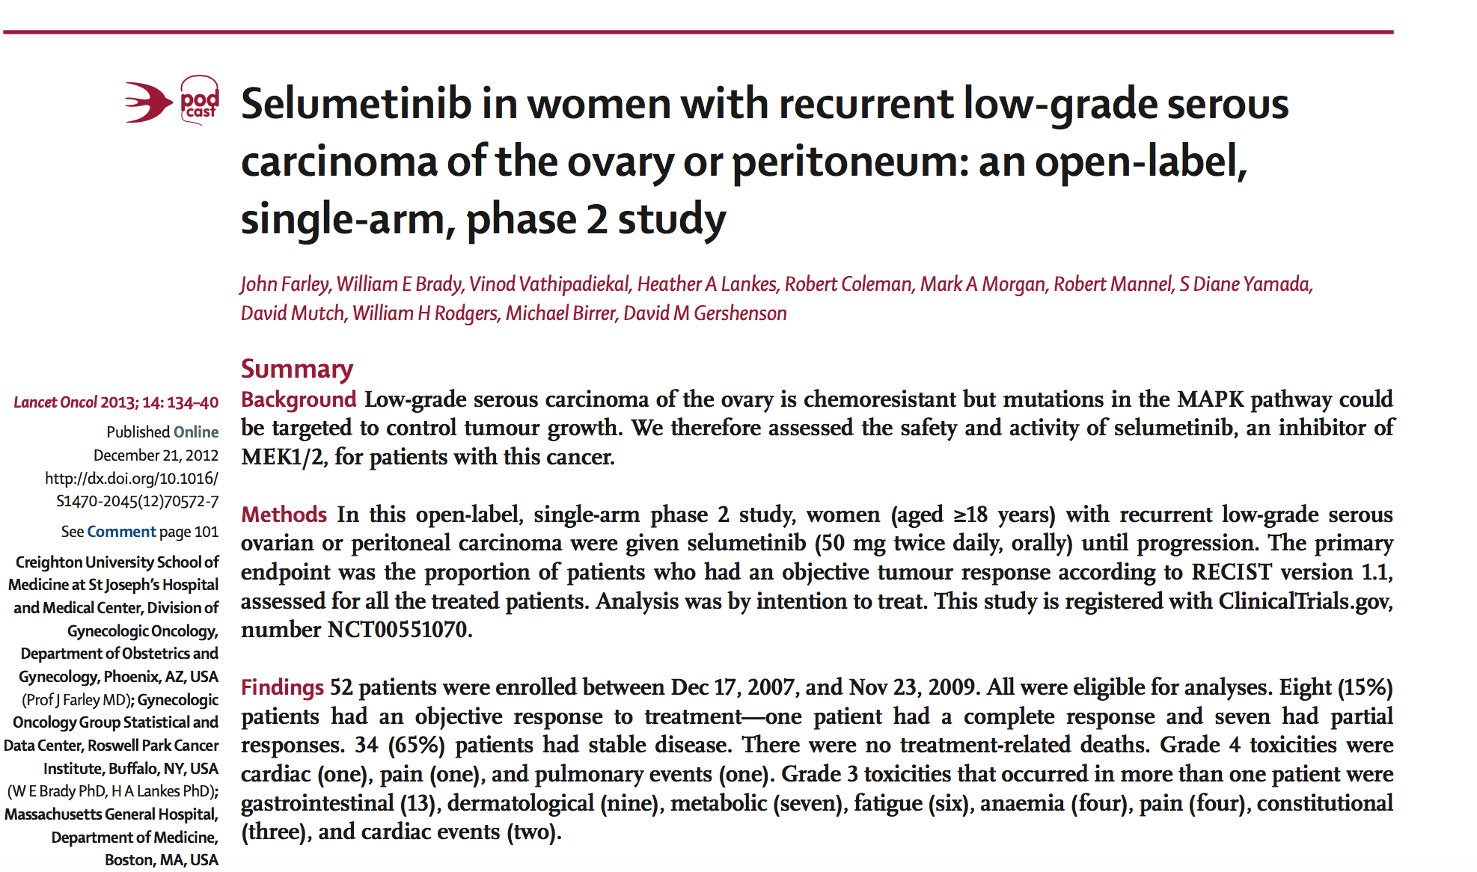
GOG 0239
Phase II study of selumetinib (MEKi) in 52 women with recurrent LGSC
ORR = 15%
Clinical benefit rate = 80%
No correlation of outcome with KRAS/ BRAF mutations

Slide 44
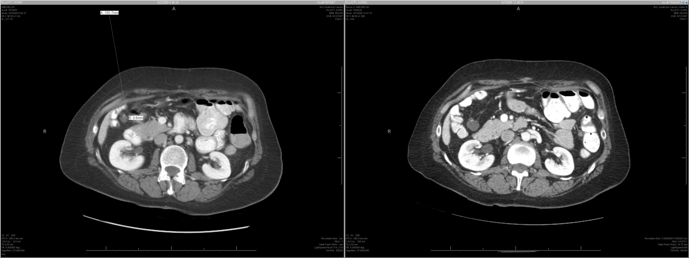
Tumor with KRAS mutation responded to Selumetinib
2/10/2009
6/2/2009
1.8 cm
0.9 cm

Slide 45

Following 100 monthly cycles of selumetinib on GOG-0239

Slide 46
NCT01849874
MILO Trial
Randomized Phase III Trial
Recurrent LGSC
Physician’s Choice:
Paclitaxel
Liposomal Doxorubicin
Topotecan
MEK162

Slide 47
NCT02101788
GOG-0281
Randomized Phase III Trial
Recurrent LGSC
Physician’s Choice:
Weekly Paclitaxel
Liposomal Doxorubicin
Topotecan
Letrozole
Tamoxifen
Trametinib

Slide 48
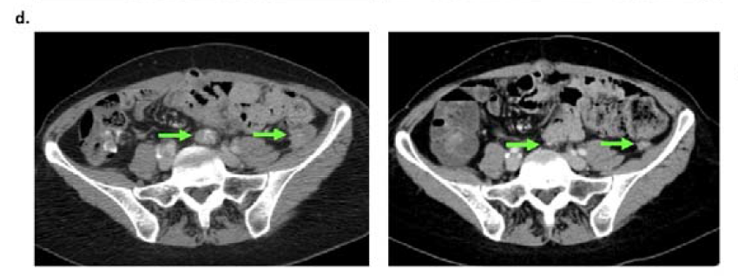
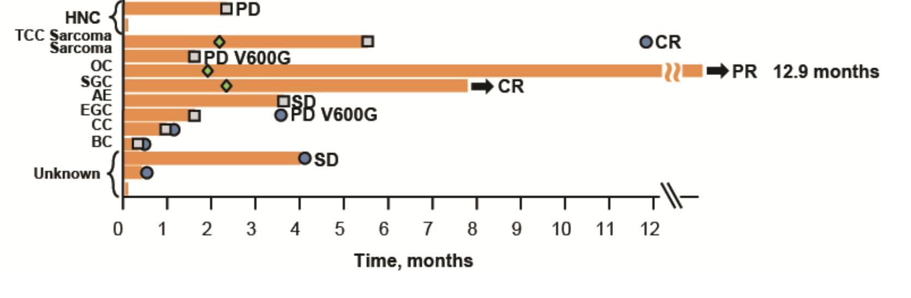
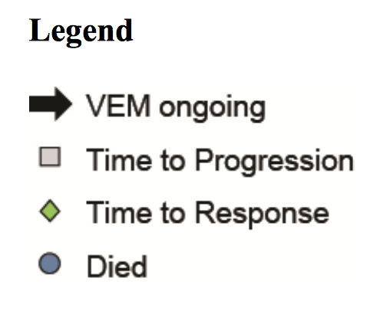
A Low-Grade Ovarian Serous Cancer Patient with BRAF V600E Mutation Responded to
Vemurafenib Monotherapy
LGOSC
Hyman DM et al.
N Engl J Med 2015

Slide 49
Phase I Study of Selumetinib + Olaparib in Women with KRAS Mutant Tumors (SOLAR)
KRAS Mutated
Solid Tumors
Selumetinib
+
Olaparib

Slide 50
Low-Grade Serous Carcinoma is Similar to ER+ Breast Cancer
At least 80% of LGSC are ER+
Women < 35 yrs have significantly worse survival
LGSC responds to anti-estrogen hormonal therapy (AI, tamoxifen, leuprolide, fulvestrant, etc.) in the recurrent setting (ORR = 9%)
Following primary surgery and platinum/taxane chemotherapy, hormonal maintenance therapy is associated with superior PFS and OS compared to observation
Following primary surgery, hormonal monotherapy appears promising
Wong et al.
Int J Gynecol Pathol 2007
Gershenson et al.
Gynecol Oncol 2012
Gershenson et al.
J Clin Oncol 2015
Gershenson et al.
J Clin Oncol 2017
Smyth et al.
Clin Cancer Res 2007
Sieh et al.
Lancet Oncol 2013
Fader et al.
Gynecol Oncol 2017

Slide 51
A Phase II Trial of Letrozole + Ribociclib in Women with Recurrent Low-Grade Serous Carcinoma
Recurrent
Low-Grade Serous Carcinoma
Letrozole 2.5 mg daily
+
Ribociclib 600 mg x 21d
then 7d off
Sponsor: Novartis
GOG Foundation Trial
Target: 50 pts
Active as of May 2019

Slide 52
Pilot Study of Neoadjuvant Fulvestrant + CDK 4/6 Inhibitor in Low-Grade Serous Ovarian Cancer
Unresectable Newly Diagnosed LGSC
Sponsor: AZ
Target: 15 pts
Estimated to activate Q2 2019
Fulvestrant + CDK 4/6 Inhibitor
X 8 weeks
CR/PR/SD:
Fulvestrant + CDK 4/6 Inhibitor
X 8 weeks
PD:
Off Study to SOC
CR/PR:
Interval CRS followed by Fulvestrant +
CDK 4/6 Inhibitor
SD:
Interval CRS followed by SOC
PD:
Optional Bx
Treat per SOC

Slide 53
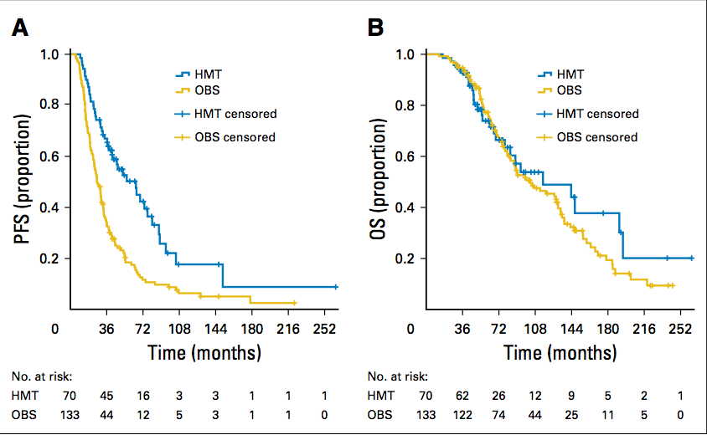
Hormonal Therapy:
Maintenance or Adjuvant
MD Anderson Study
Johns Hopkins Study
203 pts (133 OBS, 70 HMT)
27 pts with stage II-IV LGSC
Primary CRS + HT
Median duration HT = 18 mo
After median FU = 41 mo, 6 (22%) pts relapsed
Median PFS and OS not reached
3-yr PFS = 79.0%
3-yr OS = 93.1%
Gershenson et al.
J Clin Oncol 2017
Nickles Fader et al.
Gynecol Oncol 2017

Slide 54
NRG-GY-019:
Randomized Phase III Trial of Paclitaxel/Carboplatin Followed by Maintenance Letrozole versus Letrozole Monotherapy in
Stage II-IV Low-Grade Serous Carcinoma
Paclitaxel
+
Carboplatin
X 6 cycles
Letrozole 2.5 mg
daily until
disease progression
Primary
Cytoreductive
Surgery
Stage II-IV
Low-Grade
Serous Carcinoma
Sponsor: NCI (NRG Oncology)
International phase III trial
Primary Objective: PFS
Target: 450 pts
Estimated to activate Q2 2019
Letrozole 2.5 mg
daily until
disease progression

Slide 55
Low-Grade Serous Carcinoma:
Future Directions
Continue to study genomics of low-grade serous carcinoma
Await findings from MEKi trials
Conduct combination targeted agent trials
  MEKi + PARPi
  MEKi + Letrozole
  MEKi + PI3Ki
  MEKi + IGF-1R inhibitor
  MEKi + Metformin
  MEKi + BRAFi
Activate trials focused on hormonal therapy

Slide 56
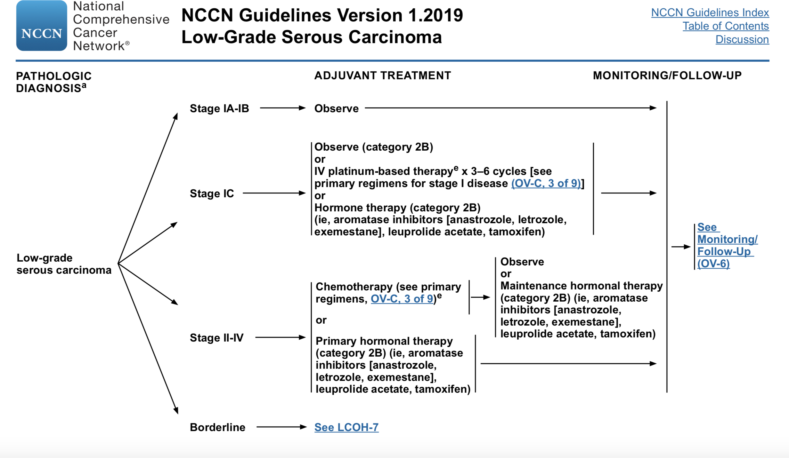

Slide 57
SMALL CELL CARCINOMA OF OVARY—HYPERCALCEMIC TYPE

Slide 58
Small Cell Carcinoma of the Ovary Hypercalcemic Type
SCCOHT
Highly aggressive
Mean age = 24 y
Unilateral
400 cases reported to date
Most diagnosed in advanced stage
Characterized by germline or somatic mutations in SMARCA4 gene
Standard Treatment:
  Surgery
  Platinum-based chemotherapy: Etoposide/platinum, BEP, VPCBAE, HD Chemo, etc.
  Radiotherapy may play a role

Slide 59
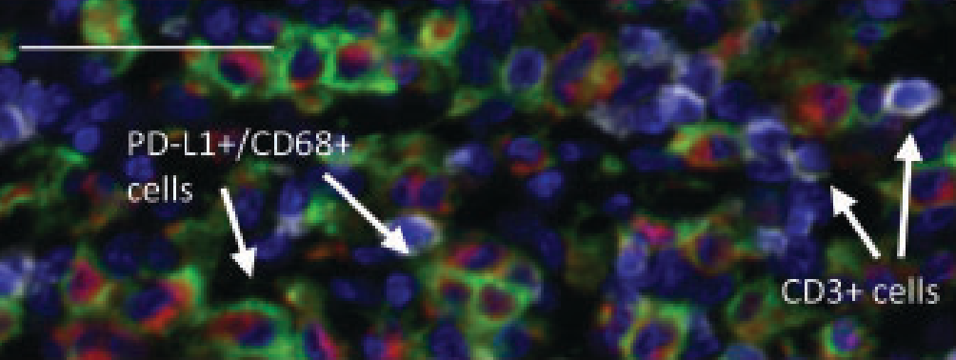
SCCOHT
Role of Immunotherapy
8 of 11 cases of SCCOHT demonstrated PD-L1 expression and strong associated T-cell infiltration
Reported responses to anti-PD1 immunotherapy in 4 patients
  1 pt had sustained PR for 6 months
  3 pts remained disease-free for 1.5 yr or more
Jelinic et al.
JNCI 2018

Slide 60
CARCINOSARCOMA

Slide 61
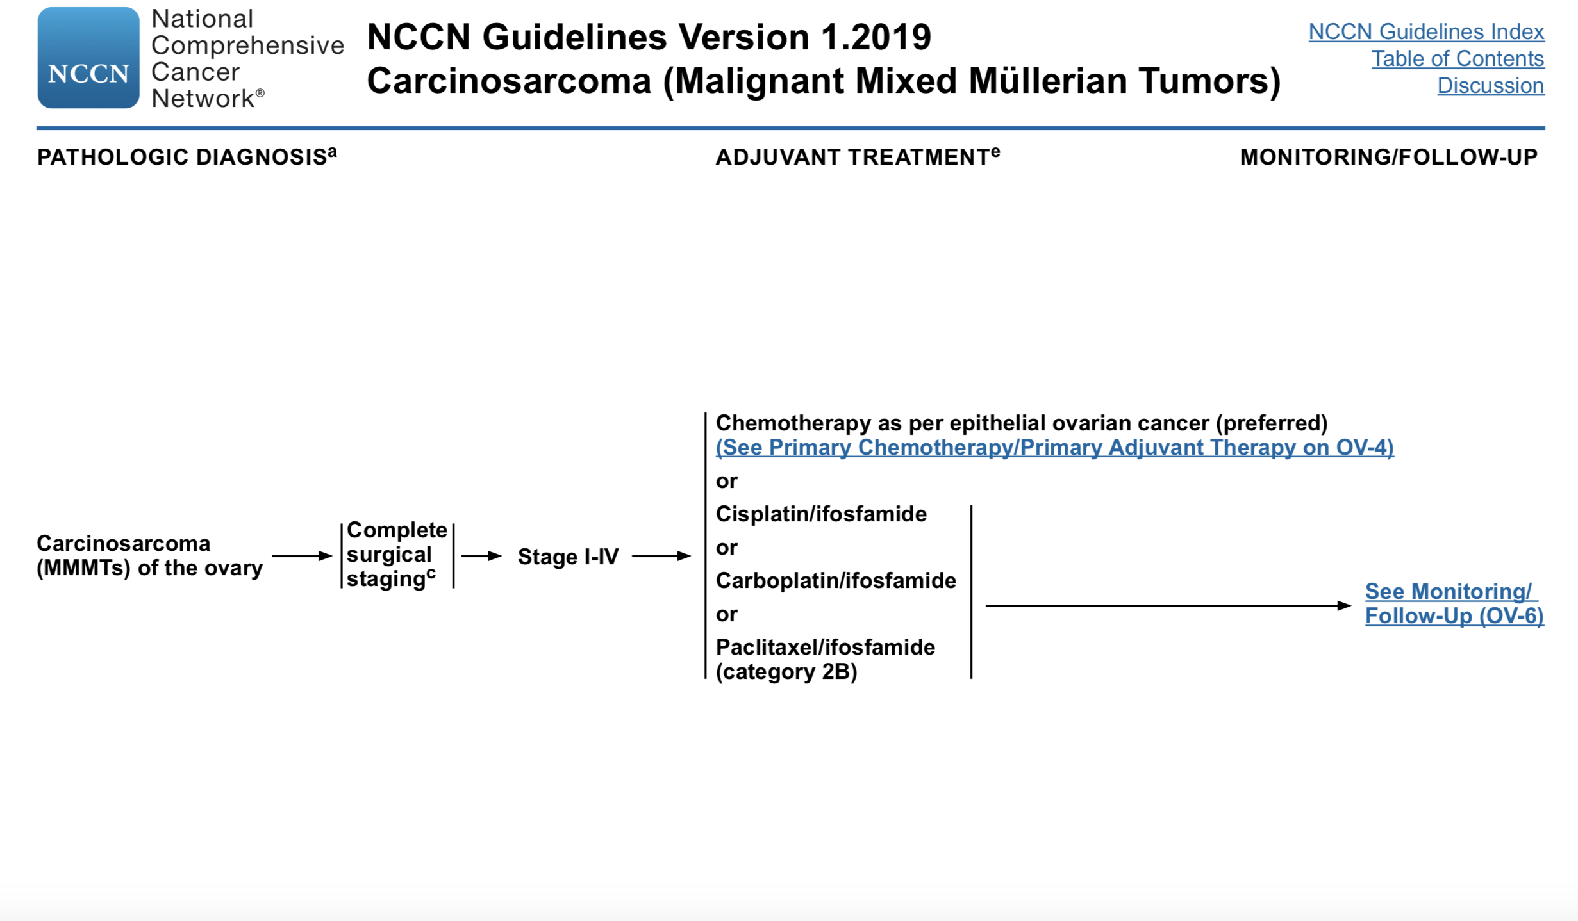

Slide 62
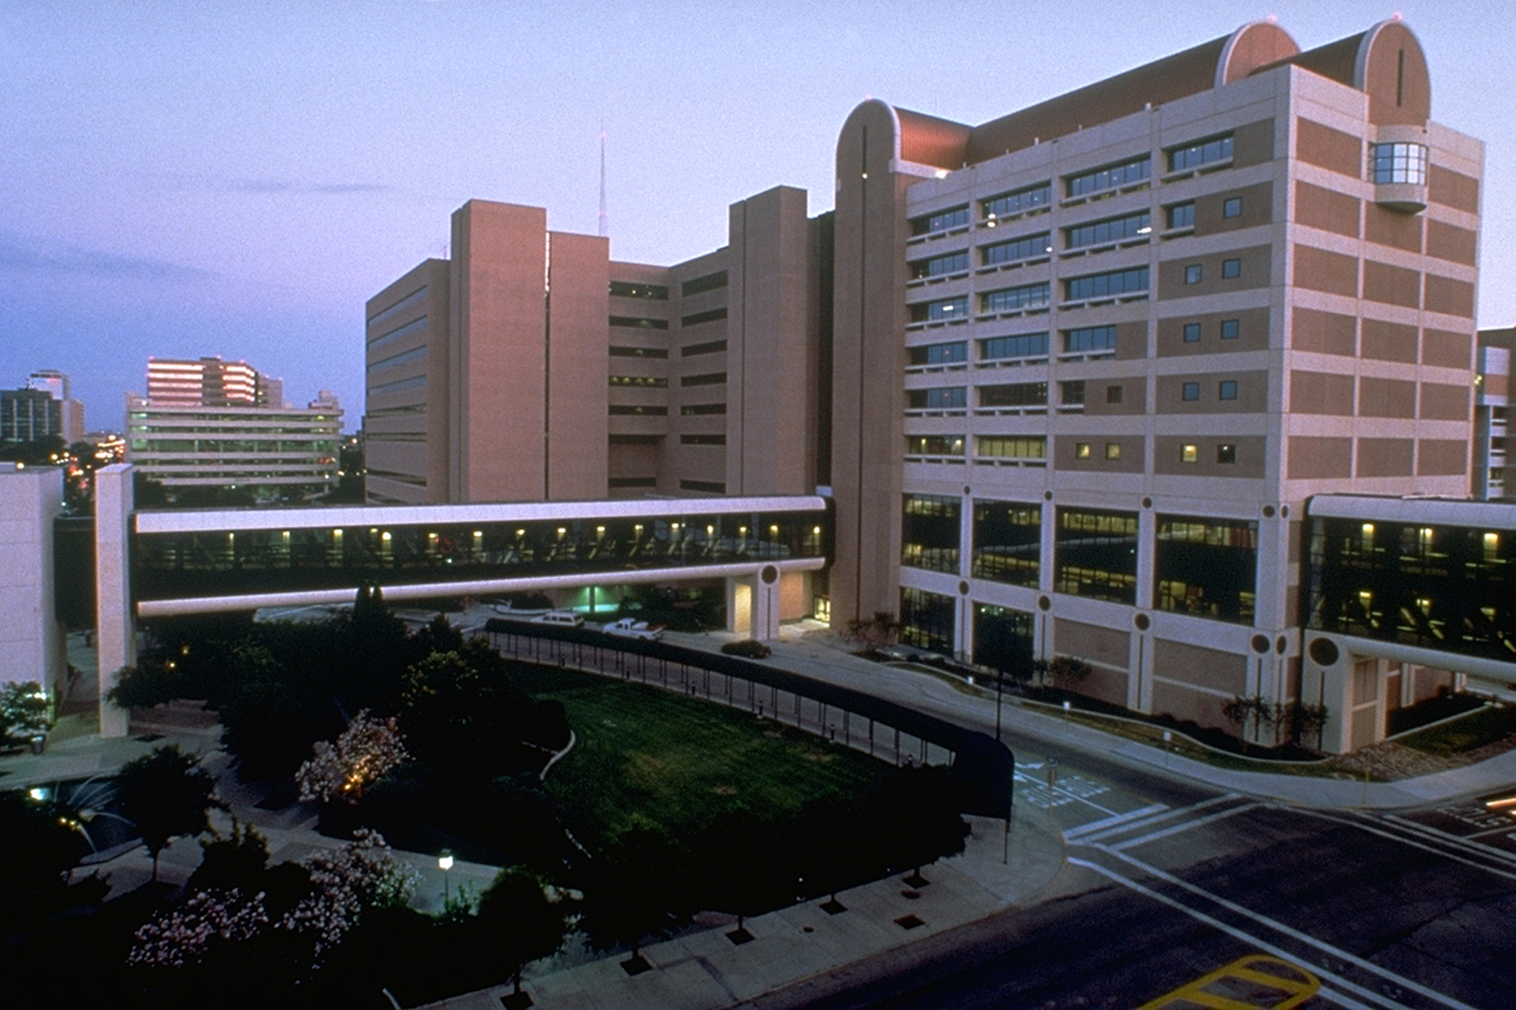
Thank You!!

